Slide 1


Team: NinjaX:
Muhammad Faran Akram
Solomon Chibuzo Nwafor

Slide 2
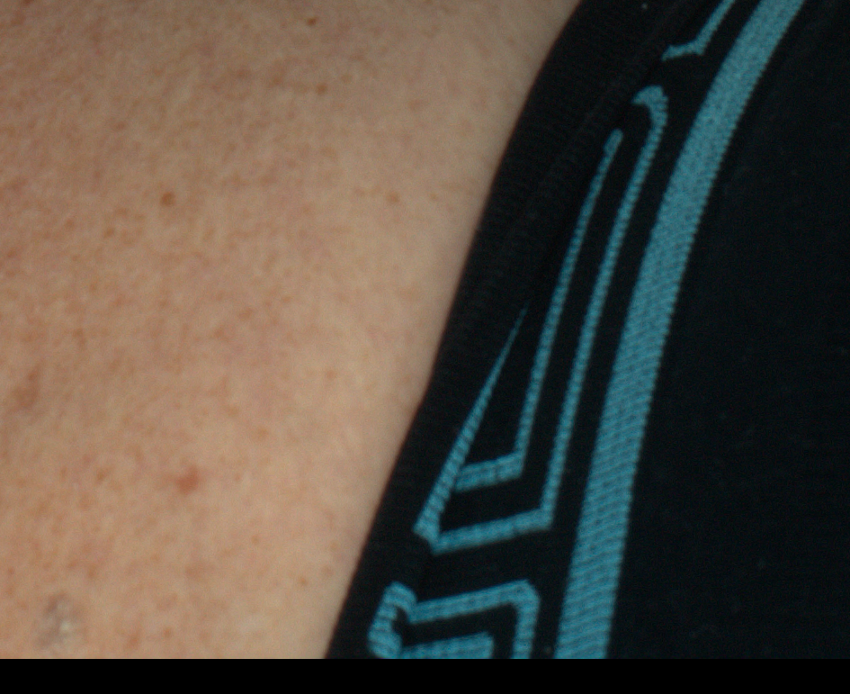
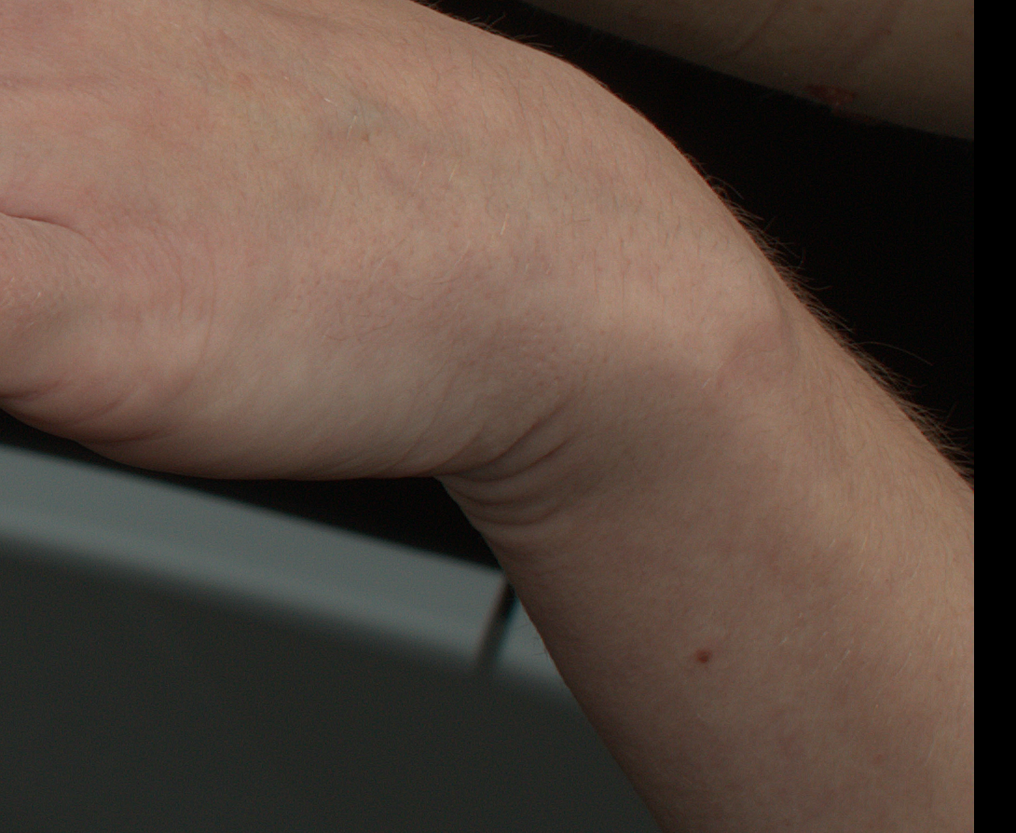
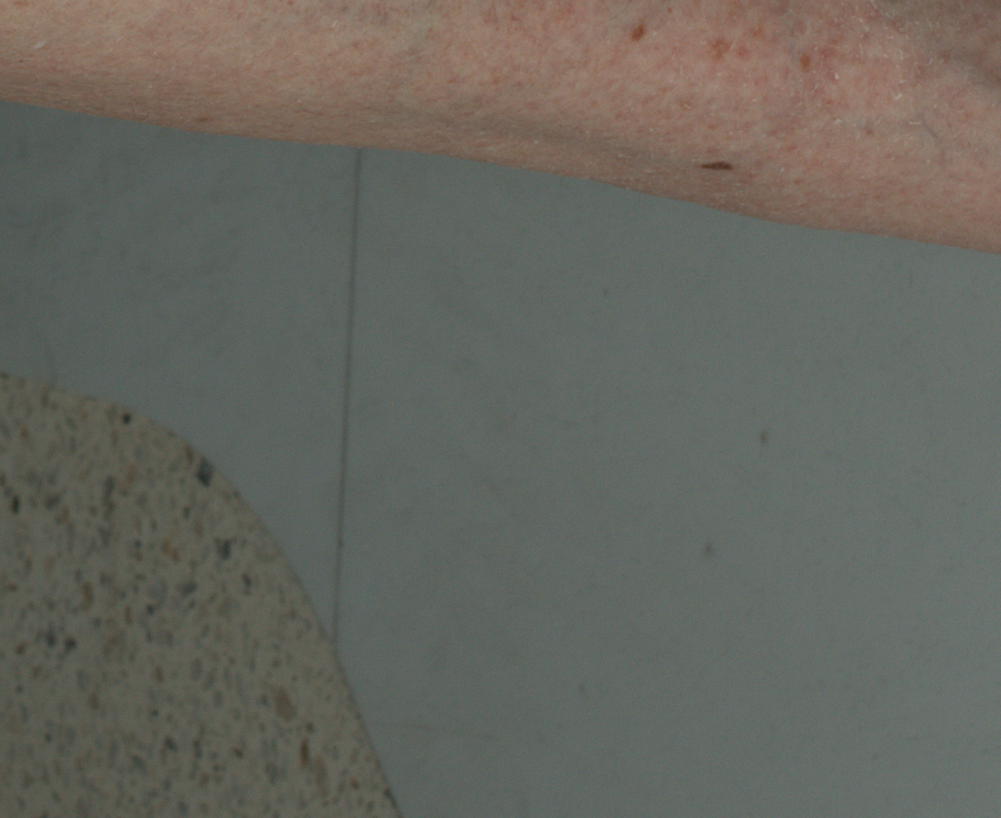
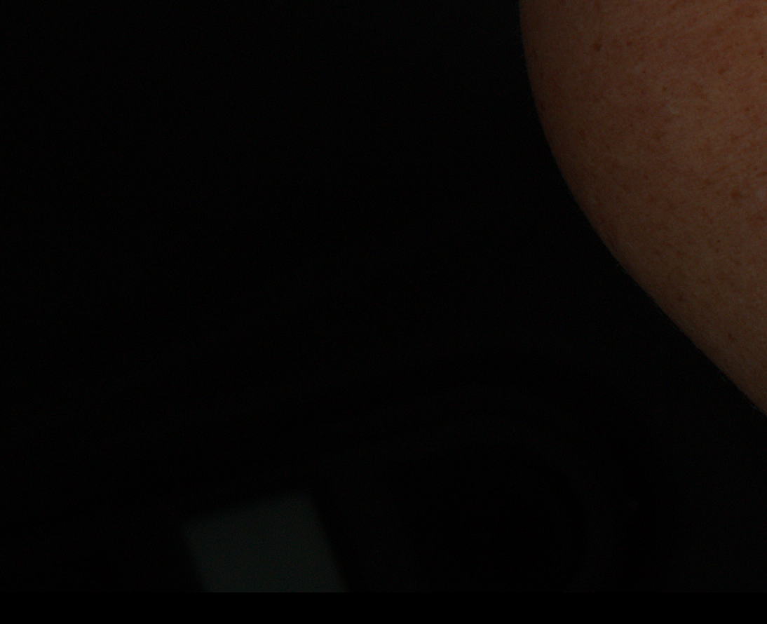
Data Insights:
Provided Data
Train Data: 8,473
Lesion images: 6,723
Non-Lesion images: 1,750
Test Data: 8,481
Split-Data
Train: 6,778 Validation:1,695
Insights
Blurred Images.
Shape variations.
High Resolution.
Dominant Background.
Brightness effects.
Similar-looking non-lesions.
2

Slide 3
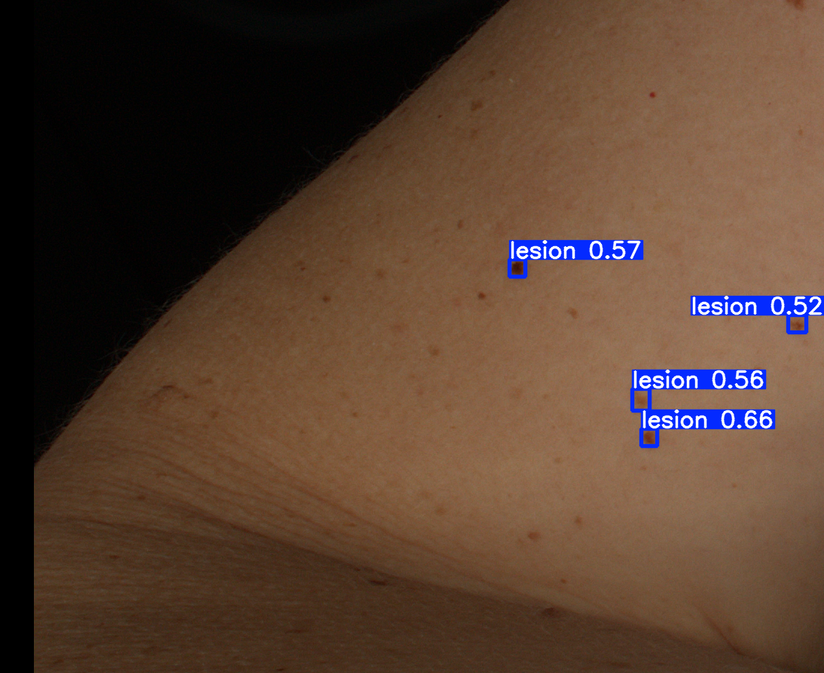
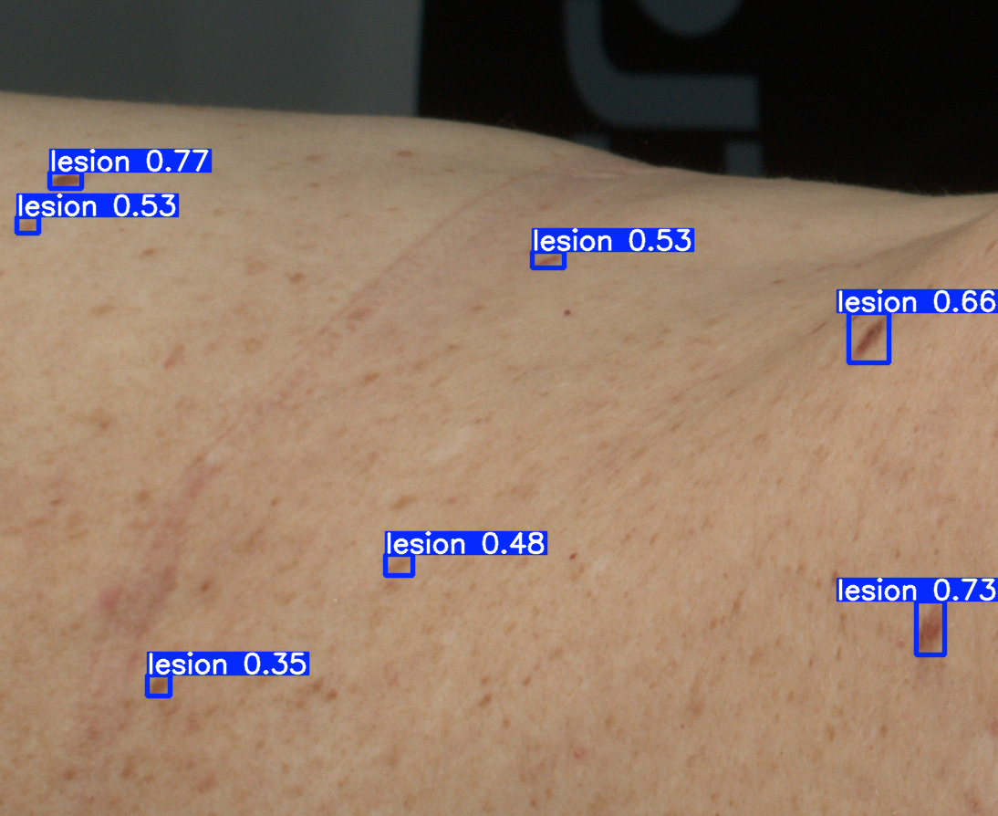
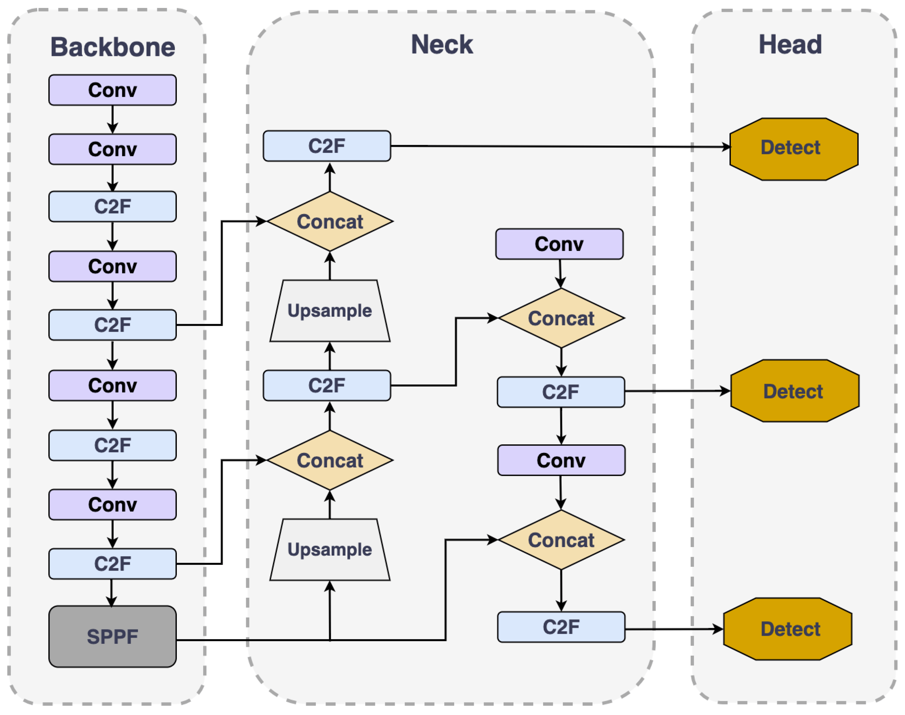
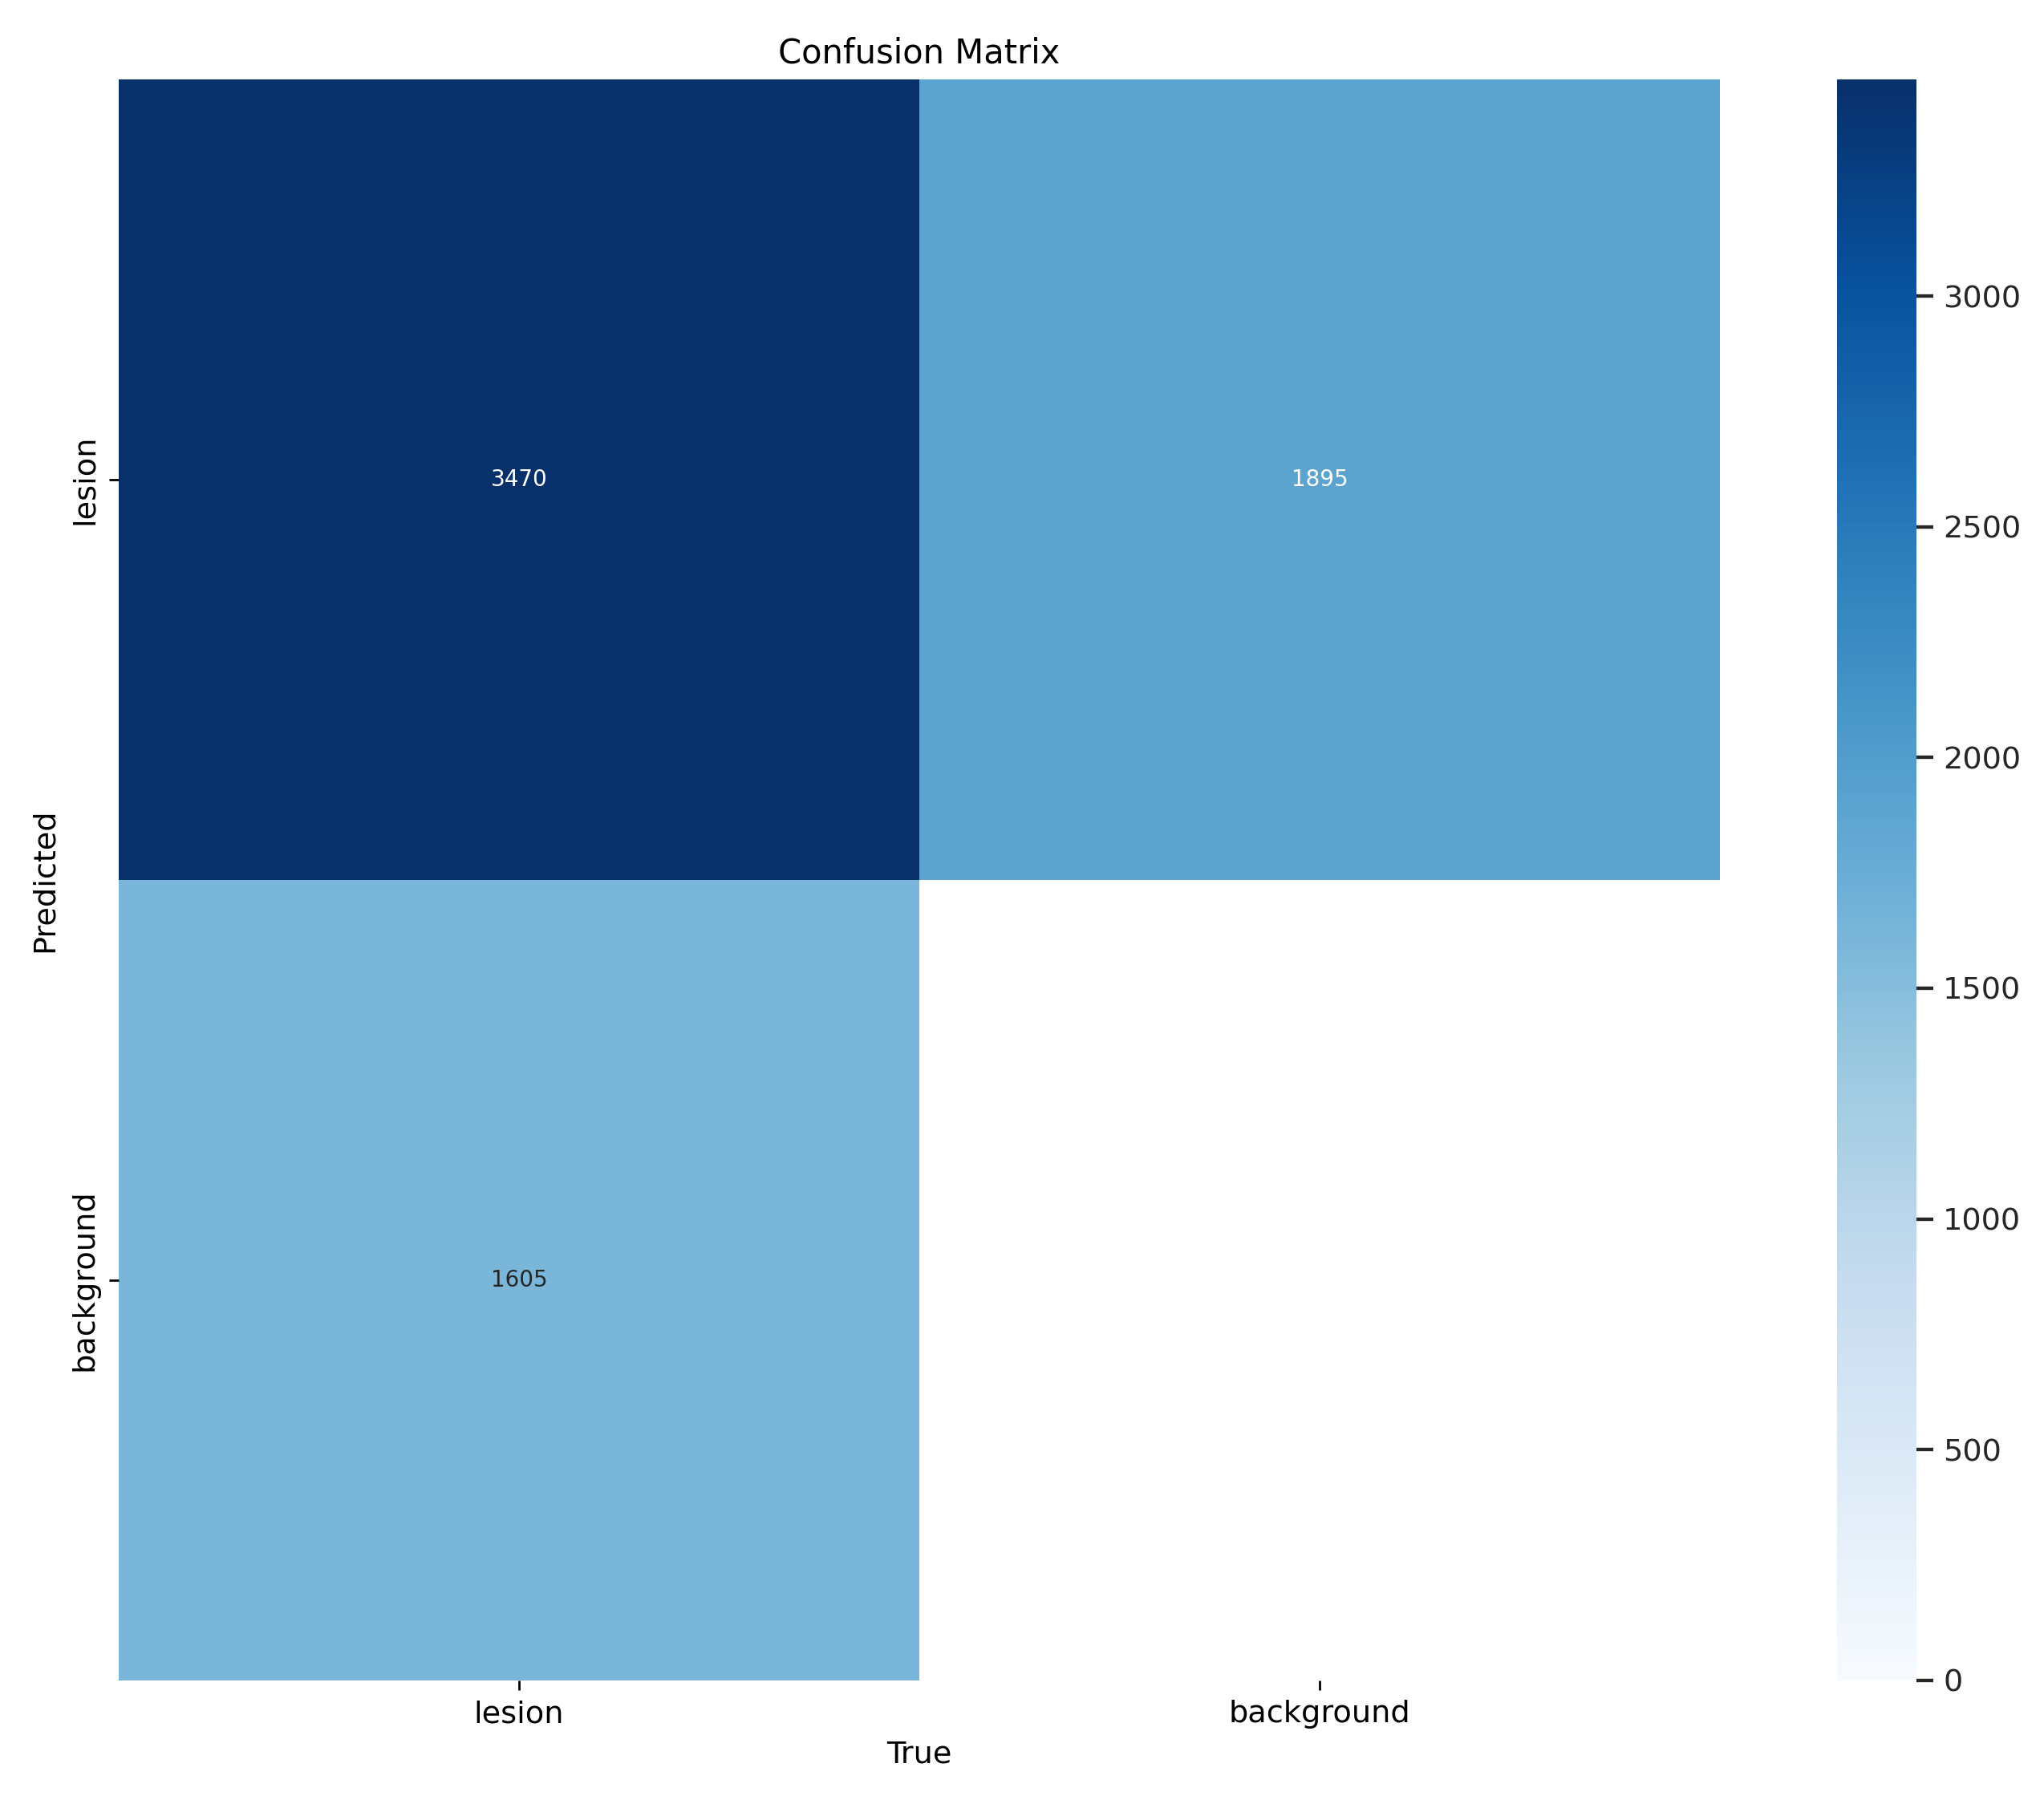
Model:
Decoupled Head
3470 (TP)
1895
(FP)
Limited Compute Resources
1605
(FN)
Yolov8n
3

Slide 4
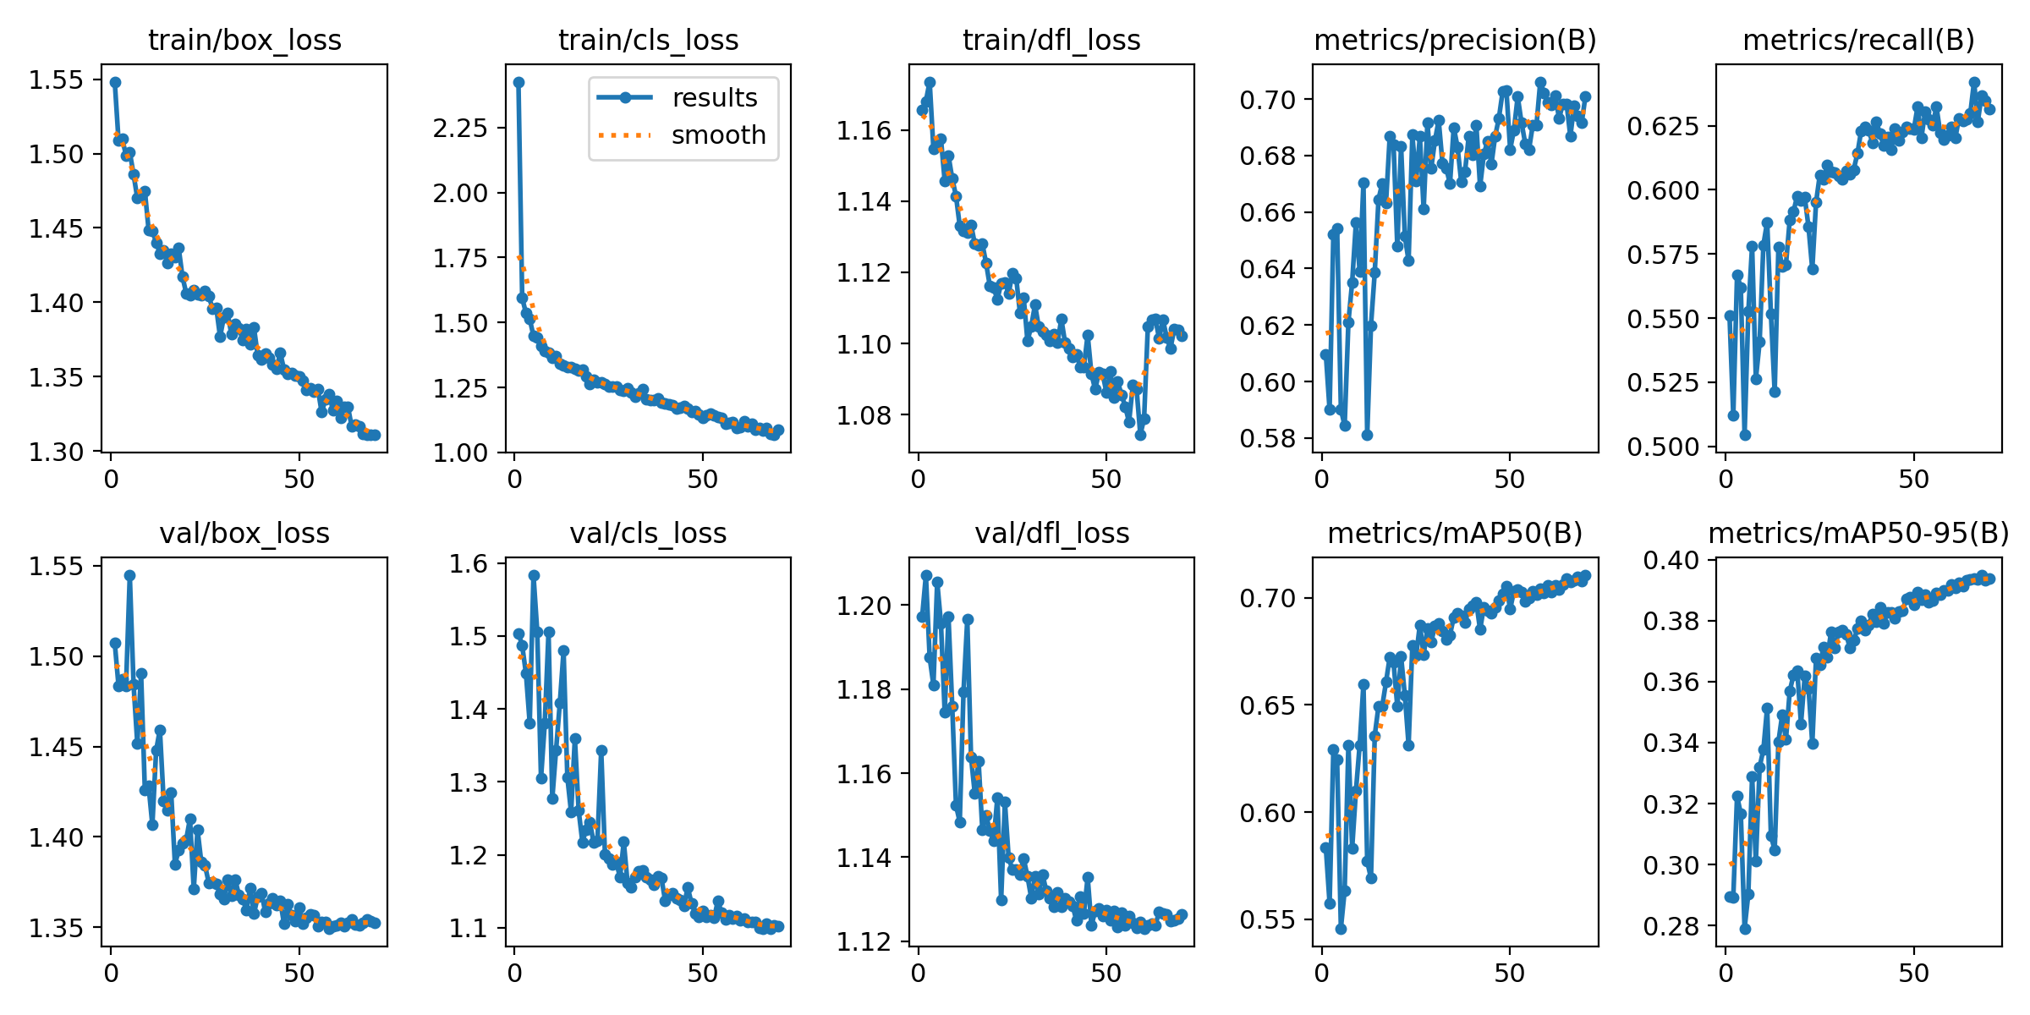
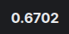
Results:
First Half (Yolo)
First Half (Yolo)
4

Slide 5
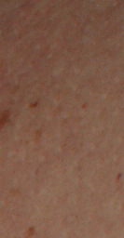

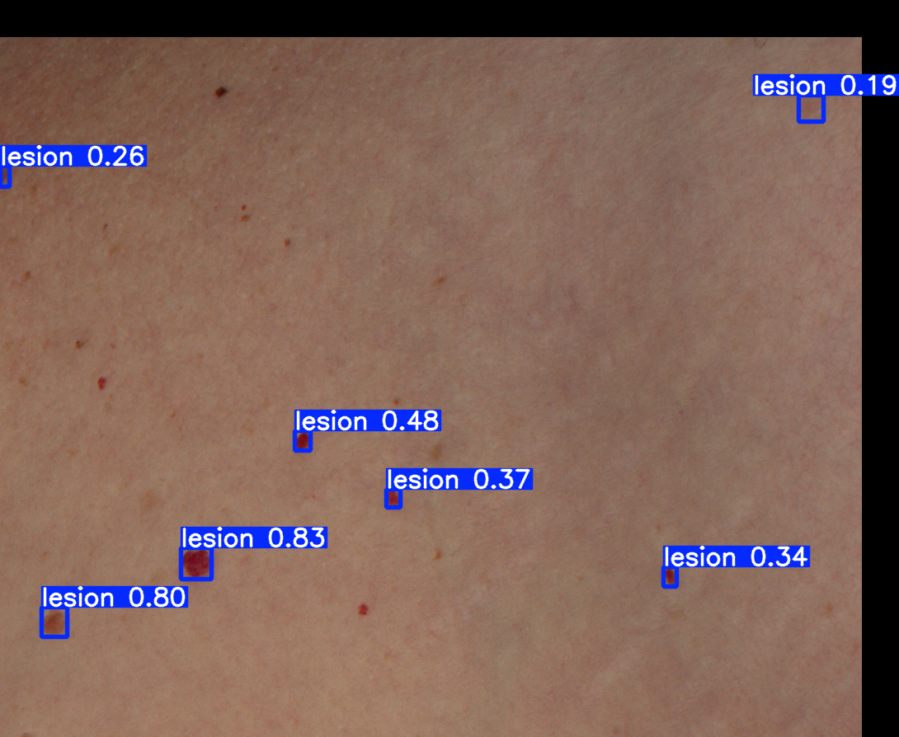
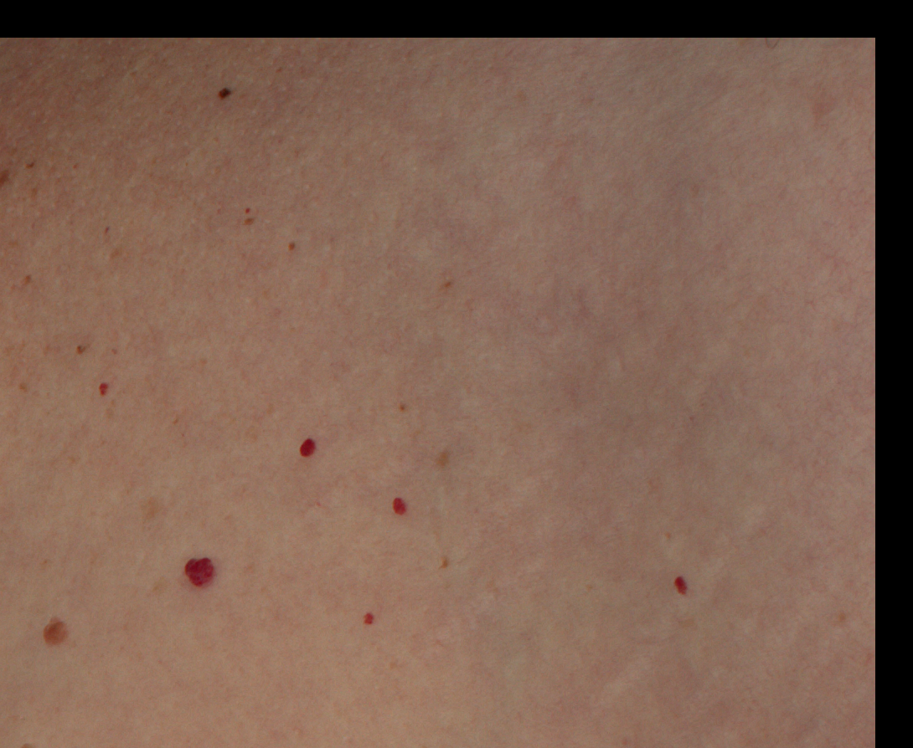
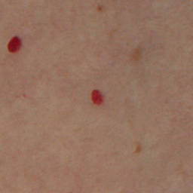

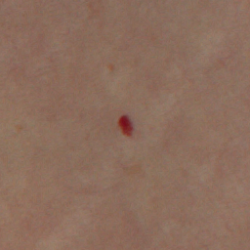
Pipeline:
Detection Dataset
Train Images: ~8.5k
Classification Dataset
Lesion: ~29k
Non-Lesion: ~18k
Yolov8n
ViT
Input Image
Low confidence detections
Fine-tunned Yolov8
Fine-tunned
Vision
Transformer
ROIs
(Cropped
Neighborhood)
Filtered Output
5

Slide 6
Results:
First Half (Yolo)
First Half (Yolo+ViT)
Second Half (Yolo+ViT)
6

Slide 7
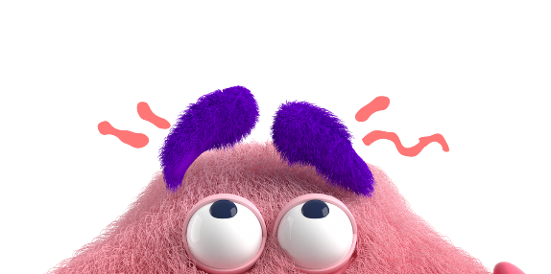
Thank You
7

